Slide 1


Management Review
Sales Department Dec 11, 2020

Slide 2
1. Sales Amount (Total)
 |  |  |  |  |  |  |  |  |  |  |  |  | K / Baht
MONTH | JAN | FEB | MAR | APR | MAY | JUN | JUL | AUG | SEP | OCT | NOV | DEC | TOTAL | %
2019 Actual : Total | 138,619 | 148,628 | 151,907 | 157,671 | 154,734 | 153,728 | 140,086 | 129,938 | 138,786 | 140,498 | 133,087 | 120,698 | 1,708,378
2020 Plan : Total | 135,619 | 150,628 | 155,907 | 157,671 | 154,734 | 153,728 | 150,086 | 135,938 | 145,786 | 147,498 | 135,087 | 130,698 | 1,753,378 | 103%
2020 Actual : Total | 143,579 | 145,129 | 146,848 | 111,382 | 85,594 | 80,457 | 106,562 | 107,651 | 118,472 | 137,543 | 139,682 | 131,089 | 1,453,987 | 83%
Diff. Act 2019 | 104% | 98% | 97% | 71% | 55% | 52% | 76% | 83% | 85% | 98% | 105% | 109%
Diff. Plan 2020 | 106% | 96% | 94% | 71% | 55% | 52% | 71% | 79% | 81% | 93% | 103% | 100%
REMARK : KPI GOAL +3 %
Acc 2019 Act. | 138,619 | 287,247 | 439,155 | 596,825 | 751,559 | 905,286 | 1,045,372 | 1,175,310 | 1,314,096 | 1,454,593 | 1,587,680 | 1,708,378
Acc 2020 Plan | 135,619 | 286,247 | 442,155 | 599,825 | 754,559 | 908,286 | 1,058,372 | 1,194,310 | 1,340,096 | 1,487,593 | 1,622,680 | 1,753,378
Acc 2020 Amount | 143,579 | 288,708 | 435,556 | 546,938 | 632,532 | 712,988 | 819,550 | 927,201 | 1,045,673 | 1,183,216 | 1,322,898 | 1,453,987
VS. 2019 (%) | 4% | 1% | -1% | -8% | -16% | -21% | -22% | -21% | -20% | -19% | -17% | -15%

Slide 3
1.1 Sales Amount (AIC)
MONTH | JAN | FEB | MAR | APR | MAY | JUN | JUL | AUG | SEP | OCT | NOV | DEC | TOTAL | %
2019 Actual | 94,575 | 102,462 | 105,856 | 98,476 | 99,762 | 97,619 | 91,612 | 79,094 | 87,352 | 89,889 | 90,004 | 86,988 | 1,123,689
2020 Plan | 100,397 | 108,734 | 111,815 | 103,177 | 103,929 | 101,571 | 95,453 | 82,358 | 90,309 | 93,132 | 93,572 | 90,965 | 1,175,412 | 105%
2020 Actual | 100,373 | 96,615 | 109,096 | 73,806 | 53,819 | 52,426 | 61,178 | 62,393 | 78,554 | 85,282 | 84,648 | 88,920 | 947,111 | 81%
Diff. | 106% | 94% | 103% | 75% | 54% | 54% | 67% | 79% | 90% | 95% | 94% | 102% | 84%
REMARK : KPI GOAL + 5 %
Acc 2019 Act. | 94,575 | 197,036 | 302,892 | 401,369 | 501,131 | 598,751 | 690,363 | 769,457 | 856,808 | 946,698 | 1,036,701 | 1,123,689
Acc 2020 Plan | 100,397 | 209,131 | 320,946 | 424,123 | 528,052 | 629,623 | 725,076 | 807,434 | 897,743 | 990,875 | 1,084,447 | 1,175,412
Acc 2020 Amount | 100,373 | 196,988 | 306,084 | 379,890 | 433,709 | 486,135 | 547,314 | 609,707 | 688,261 | 773,543 | 858,191 | 947,111
VS. 2019 (%) | 6% | 0% | 1% | -5% | -13% | -19% | -21% | -21% | -20% | -18% | -17% | -16%

Slide 4
1.2 Sales Amount (F/L)
 |  |  |  |  |  |  |  |  |  |  |  |  | K / Baht
MONTH | JAN | FEB | MAR | APR | MAY | JUN | JUL | AUG | SEP | OCT | NOV | DEC | TOTAL | %
2019 Actual | 30,171 | 29,463 | 31,367 | 27,125 | 31,460 | 27,070 | 25,949 | 28,856 | 28,512 | 32,171 | 28,186 | 21,829 | 342,159
2020 Plan | 31,000 | 30,000 | 28,000 | 30,000 | 29,000 | 30,000 | 29,000 | 29,000 | 30,000 | 31,000 | 29,000 | 25,000 | 351,000 | 103%
2020 Actual | 25,666 | 26,958 | 20,204 | 9,906 | 6,210 | 16,521 | 15,239 | 23,102 | 28,454 | 34,925 | 33,472 | 30,189 | 270,844 | 77%
Diff. | 85% | 91% | 64% | 37% | 20% | 61% | 59% | 80% | 100% | 109% | 119% | 138% | 79%
REMARK : KPI GOAL + 3%
Acc 2019 Act. | 30,171 | 59,634 | 91,001 | 118,126 | 149,586 | 176,656 | 202,605 | 231,461 | 259,973 | 292,144 | 320,330 | 342,159
Acc 2020 Plan | 31,000 | 61,000 | 89,000 | 119,000 | 148,000 | 178,000 | 207,000 | 236,000 | 266,000 | 297,000 | 326,000 | 351,000
Acc 2020 Amount | 25,666 | 52,624 | 72,828 | 82,733 | 88,943 | 105,463 | 120,702 | 143,804 | 172,258 | 207,183 | 240,655 | 270,844
VS. 2019 (%) | -15% | -12% | -20% | -30% | -41% | -40% | -40% | -38% | -34% | -29% | -25% | -21%

Slide 5
1.3 Sales Amount (IIC)
 |  |  |  |  |  |  |  |  |  |  |  |  | K / Baht
MONTH | JAN | FEB | MAR | APR | MAY | JUN | JUL | AUG | SEP | OCT | NOV | DEC | TOTAL | %
2019 Actual | 6,761 | 8,658 | 9,314 | 25,128 | 15,593 | 21,772 | 16,544 | 13,266 | 15,924 | 9,579 | 9,217 | 7,682 | 159,438
2020 Plan | 6,500 | 9,200 | 9,500 | 25,000 | 17,000 | 22,000 | 17,000 | 14,000 | 17,000 | 12,000 | 10,000 | 5,000 | 164,200 | 103%
2020 Actual | 9,128 | 14,250 | 9,128 | 22,790 | 20,472 | 16,497 | 25,458 | 16,570 | 4,691 | 8,714 | 15,092 | 5,000 | 167,792 | 102%
Diff. | 135% | 165% | 98% | 91% | 131% | 76% | 154% | 125% | 29% | 91% | 164% | 65% | 105%
REMARK : KPI GOAL + 3%
Acc 2019 Act. | 6,761 | 15,419 | 24,733 | 49,861 | 65,454 | 87,226 | 103,770 | 117,036 | 132,960 | 142,539 | 151,756 | 159,438
Acc 2020 Plan | 6,500 | 15,700 | 25,200 | 50,200 | 67,200 | 89,200 | 106,200 | 120,200 | 137,200 | 149,200 | 159,200 | 164,200
Acc 2020 Amount | 9,128 | 23,379 | 32,507 | 55,297 | 75,770 | 92,266 | 117,725 | 134,295 | 138,986 | 147,700 | 162,792 | 167,792
VS. 2019 (%) | 35% | 52% | 31% | 11% | 16% | 6% | 13% | 15% | 5% | 4% | 7% | 5%

Slide 6
1.4 Sales Amount (Internal)
 |  |  |  |  |  |  |  |  |  |  |  |  | K / Baht
MONTH | JAN | FEB | MAR | APR | MAY | JUN | JUL | AUG | SEP | OCT | NOV | DEC | TOTAL | %
2019 Actual | 7,112 | 8,045 | 5,371 | 6,940 | 7,881 | 7,252 | 5,702 | 8,722 | 6,998 | 8,858 | 5,680 | 4,199 | 82,760
2020 Plan | 6,500 | 7,200 | 7,500 | 8,000 | 8,000 | 6,000 | 7,000 | 7,000 | 7,500 | 7,300 | 6,500 | 7,000 | 85,500 | 103%
2020 Actual | 8,411 | 7,306 | 8,420 | 4,880 | 5,093 | 2,825 | 4,686 | 5,585 | 6,773 | 8,621 | 6,470 | 7,000 | 76,071 | 89%
Diff. | 118% | 91% | 157% | 70% | 65% | 39% | 82% | 64% | 97% | 97% | 114% | 167% | 92%
REMARK : KPI GOAL + 3%
Acc 2019 Act. | 7,112 | 15,157 | 20,528 | 27,468 | 35,349 | 42,601 | 48,303 | 57,025 | 64,023 | 72,881 | 78,561 | 82,760
Acc 2020 Plan | 6,500 | 13,700 | 21,200 | 29,200 | 37,200 | 43,200 | 50,200 | 57,200 | 64,700 | 72,000 | 78,500 | 85,500
Acc 2020 Amount | 8,411 | 15,717 | 24,137 | 29,018 | 34,111 | 36,936 | 41,622 | 47,207 | 53,980 | 62,601 | 69,071 | 76,071
VS. 2019 (%) | 18% | 4% | 18% | 6% | -4% | -13% | -14% | -17% | -16% | -14% | -12% | -8%

Slide 7
2. SALES AMOUNT TOTAL ( MAIN 10 CUSTOMERS)
2.1 Sales Amount (DIT)
 |  |  |  |  |  |  |  |  |  |  |  |  | K : Baht
No. | DIT | Jan | Feb | Mar | Apr | May | Jun | Jul | Aug | Sep | Oct | Nov | Dec | Total
 | 2019 Actual | 24,465 | 24,412 | 29,272 | 26,119 | 29,818 | 30,742 | 27,112 | 21,090 | 25,130 | 26,018 | 25,043 | 21,010 | 310,233
 | 2020 Plan | 24,954 | 24,901 | 29,858 | 26,380 | 30,117 | 31,049 | 26,841 | 20,879 | 24,879 | 25,497 | 24,543 | 20,590 | 310,488
1 | 2020 Actual | 25,986 | 24,290 | 27,465 | 23,475 | 18,549 | 18,434 | 18,364 | 13,246 | 17,315 | 19,655 | 20,387 | 20,000 | 247,166
 | Sub ass'y Total | 914 | 1,033 | 1,006 | 891 | 1,068 | 1,194 | 1,831 | 1,541 | 1,592 | 1,933 | 2,906 | 1,200 | 17,108
 | Grand Total | 26,901 | 25,323 | 28,471 | 24,366 | 19,617 | 19,629 | 20,195 | 14,787 | 18,907 | 21,588 | 23,292 | 21,200 | 264,275
 | Diff. 2019 Actual | 106% | 99% | 94% | 90% | 62% | 60% | 68% | 63% | 69% | 76% | 81% | 95%
 | Diff. 2020 Plan | 104% | 98% | 92% | 89% | 62% | 59% | 68% | 63% | 70% | 77% | 83% | 97%
Acc 2019 Act. |  | 24,465 | 48,877 | 78,150 | 104,269 | 134,087 | 164,829 | 191,941 | 213,031 | 238,161 | 264,179 | 289,222 | 310,233
Acc 2020 Plan. |  | 24,954 | 49,855 | 79,713 | 106,093 | 136,210 | 167,259 | 194,100 | 214,979 | 239,858 | 265,355 | 289,898 | 310,488
Acc 2020 Act. |  | 25,986 | 50,276 | 77,741 | 101,216 | 119,765 | 138,199 | 156,563 | 169,809 | 187,124 | 206,780 | 227,166 | 247,166
 | VS. 2019 (%) | 6% | 3% | -1% | -3% | -11% | -16% | -18% | -20% | -21% | -22% | -21% | -20%

Slide 8
2.2 Sales Amount (MCP)
 |  |  |  |  |  |  |  |  |  |  |  |  | K : Baht
No. | MCP | Jan | Feb | Mar | Apr | May | Jun | Jul | Aug | Sep | Oct | Nov | Dec | Total
 | 2019 Actual | 19,311 | 19,485 | 22,686 | 20,725 | 21,196 | 14,149 | 18,434 | 15,051 | 18,855 | 18,720 | 20,345 | 19,493 | 228,451
 | 2020 Plan | 19,118 | 19,290 | 22,459 | 20,518 | 20,984 | 18,958 | 18,250 | 14,900 | 18,666 | 18,533 | 20,142 | 19,298 | 231,116
2 | 2020 Actual | 21,256 | 20,193 | 23,759 | 7,149 | 5,430 | 7,340 | 14,290 | 12,346 | 21,409 | 20,095 | 22,151 | 19,000 | 194,418
 | Sub ass'y total | 2,029 | 1,894 | 2,757 | 1,574 | 1,207 | 1,417 | 1,596 | 1,352 | 2,059 | 2,503 | 3,047 | 1,500 | 22,936
 | Grand Total | 23,285 | 22,087 | 26,516 | 8,723 | 6,637 | 8,757 | 15,887 | 13,697 | 23,468 | 22,598 | 25,199 | 20,500 | 217,354
 | Diff. 2019 Actual | 110% | 104% | 105% | 34% | 26% | 52% | 78% | 82% | 114% | 107% | 109% | 97%
 | Diff. 2020 Plan | 111% | 105% | 106% | 35% | 26% | 39% | 78% | 83% | 115% | 108% | 110% | 98%
Acc 2019 Act. |  | 19,311 | 38,796 | 61,482 | 82,207 | 103,403 | 117,553 | 135,987 | 151,038 | 169,893 | 188,613 | 208,958 | 228,451
Acc 2020 Plan. |  | 20,000 | 39,290 | 61,749 | 82,267 | 103,251 | 122,209 | 140,459 | 155,359 | 174,025 | 192,558 | 212,700 | 231,998
Acc 2020 Act. |  | 21,256 | 41,448 | 65,207 | 72,357 | 77,787 | 85,127 | 99,417 | 111,763 | 133,172 | 153,267 | 175,418 | 194,418
 | VS. 2019 (%) | 10% | 7% | 6% | -12% | -25% | -28% | -27% | -26% | -22% | -19% | -16% | -15%

Slide 9
2.3 Sales Amount (FGT)
 |  |  |  |  |  |  |  |  |  |  |  |  | K : Baht
No. | FGT | Jan | Feb | Mar | Apr | May | Jun | Jul | Aug | Sep | Oct | Nov | Dec | Total
 | 2019 Actual | 5,601 | 6,866 | 5,939 | 6,162 | 5,031 | 4,291 | 4,688 | 3,937 | 3,524 | 3,629 | 5,371 | 6,197 | 61,235
 | 2020 Plan | 6,722 | 8,239 | 7,127 | 7,394 | 6,037 | 5,149 | 5,626 | 4,724 | 4,228 | 4,355 | 6,445 | 7,437 | 73,483
3 | 2020 Actual | 6,972 | 8,355 | 6,262 | 4,490 | 3,599 | 4,912 | 2,867 | 3,113 | 2,808 | 4,593 | 5,071 | 3,700 | 56,744
 | Sub ass'y total | 3,827 | 4,547 | 3,978 | 3,939 | 9,635 | 715 | 1,184 | 2,269 | 1,561 | 3,371 | 3,626 | 2,300 | 40,953
 | Grand Total | 10,799 | 12,903 | 10,241 | 8,429 | 13,234 | 5,627 | 4,051 | 5,383 | 4,370 | 7,965 | 8,697 | 6,000 | 97,697
 | Diff. 2019 Actual | 124% | 122% | 105% | 73% | 72% | 114% | 61% | 79% | 80% | 127% | 94% | 60%
 | Diff. 2020 Plan | 104% | 101% | 88% | 61% | 60% | 95% | 51% | 66% | 66% | 105% | 79% | 50%
Acc 2019 Act. |  | 5,601 | 12,468 | 18,407 | 24,568 | 29,599 | 33,889 | 38,578 | 42,514 | 46,038 | 49,667 | 55,038 | 61,235
Acc 2020 Plan. |  | 6,722 | 14,961 | 22,088 | 29,482 | 35,519 | 40,668 | 46,294 | 51,018 | 55,246 | 59,601 | 66,046 | 73,483
Acc 2020 Act. |  | 6,972 | 15,328 | 21,590 | 26,080 | 29,679 | 34,591 | 37,458 | 40,571 | 43,380 | 47,973 | 53,044 | 56,744
 | VS. 2019 (%) | 24% | 23% | 17% | 6% | 0% | 2% | -3% | -5% | -6% | -3% | -4% | -7%

Slide 10
2.4 Sales Amount (MACO)
 |  |  |  |  |  |  |  |  |  |  |  |  | K : Baht
No. | MACO | Jan | Feb | Mar | Apr | May | Jun | Jul | Aug | Sep | Oct | Nov | Dec | Total
 | 2019 Actual | 8,859 | 8,392 | 8,800 | 8,296 | 7,307 | 8,913 | 7,501 | 6,509 | 7,761 | 9,745 | 10,686 | 9,873 | 102,641
 | 2020 Plan | 9,214 | 8,728 | 9,152 | 8,627 | 7,600 | 9,270 | 7,801 | 6,769 | 8,072 | 10,135 | 11,113 | 10,268 | 106,749
4 | 2020 Actual | 10,157 | 8,141 | 12,396 | 5,146 | 4,643 | 6,164 | 4,595 | 5,585 | 6,860 | 7,153 | 5,823 | 6,400 | 83,061
 | Sub ass'y total | 1,996 | 1,889 | 2,229 | 2,344 | 2,159 | 1,714 | 2,008 | 1,981 | 1,488 | 1,614 | 1,443 | 1,570 | 22,435
 | Grand Total | 12,152 | 10,030 | 14,625 | 7,490 | 6,802 | 7,877 | 6,603 | 7,566 | 8,348 | 8,766 | 7,265 | 7,970 | 105,496
 | Diff. 2019 Actual | 115% | 97% | 141% | 62% | 64% | 69% | 61% | 86% | 88% | 73% | 54% | 65%
 | Diff. 2020 Plan | 110% | 93% | 135% | 60% | 61% | 66% | 59% | 83% | 85% | 71% | 52% | 62%
Acc 2019 Act. |  | 8,859 | 17,251 | 26,051 | 34,347 | 41,654 | 50,567 | 58,068 | 64,576 | 72,337 | 82,082 | 92,768 | 102,641
Acc 2020 Plan. |  | 9,214 | 17,942 | 27,094 | 35,721 | 43,321 | 52,591 | 60,392 | 67,161 | 75,233 | 85,368 | 96,481 | 106,749
Acc 2020 Act. |  | 10,157 | 18,298 | 30,694 | 35,840 | 40,483 | 46,646 | 51,241 | 56,826 | 63,686 | 70,839 | 76,661 | 83,061
 | VS. 2019 (%) | 15% | 6% | 18% | 4% | -3% | -8% | -12% | -12% | -12% | -14% | -17% | -19%

Slide 11
2.5 Sales Amount (TCTC)
 |  |  |  |  |  |  |  |  |  |  |  |  | K : Baht
No. | TCTC | Jan | Feb | Mar | Apr | May | Jun | Jul | Aug | Sep | Oct | Nov | Dec | Total
 | 2019 Actual | 1,890 | 2,520 | 2,154 | 2,094 | 2,260 | 1,658 | 1,517 | 1,581 | 1,512 | 1,392 | 1,890 | 1,392 | 21,860
 | 2020 Plan | 1,928 | 2,570 | 2,197 | 2,136 | 2,306 | 1,691 | 1,548 | 1,613 | 1,542 | 1,420 | 1,928 | 1,420 | 22,297
5 | 2020 Actual | 1,757 | 2,107 | 2,362 | 1,426 | 1,347 | 1,440 | 1,289 | 1,265 | 1,471 | 1,225 | 1,545 | 1,100 | 18,333
 | Sub ass'y total | 2,062 | 2,250 | 2,837 | 2,321 | 1,713 | 1,110 | 2,257 | 2,472 | 2,238 | 2,967 | 3,450 | 1,900 | 27,578
 | Grand Total | 3,819 | 4,358 | 5,198 | 3,747 | 3,060 | 2,550 | 3,546 | 3,736 | 3,709 | 4,191 | 4,996 | 3,000 | 45,911
 | Diff. 2019 Actual | 93% | 84% | 110% | 68% | 60% | 87% | 85% | 80% | 97% | 88% | 82% | 79%
 | Diff. 2020 Plan | 91% | 82% | 107% | 67% | 58% | 85% | 83% | 78% | 95% | 86% | 80% | 77%
Acc 2019 Act. |  | 1,890 | 4,410 | 6,564 | 8,658 | 10,918 | 12,576 | 14,093 | 15,674 | 17,186 | 18,578 | 20,468 | 21,860
Acc 2020 Plan. |  | 1,928 | 4,498 | 6,695 | 8,831 | 11,137 | 12,827 | 14,375 | 15,988 | 17,530 | 18,949 | 20,877 | 22,297
Acc 2020 Act. |  | 1,757 | 3,864 | 6,226 | 7,652 | 8,999 | 10,438 | 11,727 | 12,992 | 14,463 | 15,688 | 17,233 | 18,333
 | VS. 2019 (%) | -7% | -12% | -5% | -12% | -18% | -17% | -17% | -17% | -16% | -16% | -16% | -16%

Slide 12
2.6 Sales Amount (TPT)
 |  |  |  |  |  |  |  |  |  |  |  |  | K : Baht
No. | TPT (W/M,R/F) | Jan | Feb | Mar | Apr | May | Jun | Jul | Aug | Sep | Oct | Nov | Dec | Total
 | 2019 Actual | 2,472 | 2,103 | 2,201 | 1,262 | 970 | 1,032 | 1,322 | 889 | 605 | 724 | 681 | 858 | 15,119
 | 2020 Plan | 2,422 | 2,061 | 2,158 | 1,238 | 952 | 1,012 | 1,296 | 871 | 593 | 709 | 667 | 841 | 14,820
6 | 2020 Actual | 941 | 967 | 823 | 612 | 452 | 608 | 511 | 566 | 734 | 735 | 676 | 525 | 8,149
 | Sub ass'y total | 87 | 40 | 82 | 93 | 81 | 107 | - | 97 | 52 | 46 | 91 | 40 | 817
 | Grand Total | 1,029 | 1,007 | 905 | 705 | 533 | 716 | 511 | 663 | 786 | 780 | 767 | 565 | 8,966
 | Diff. 2019 Actual | 38% | 46% | 37% | 48% | 47% | 59% | 39% | 64% | 121% | 102% | 99% | 61%
 | Diff. 2020 Plan | 39% | 47% | 38% | 49% | 48% | 60% | 39% | 65% | 124% | 104% | 101% | 62%
Acc 2019 Act. |  | 2,472 | 4,575 | 6,776 | 8,037 | 9,008 | 10,039 | 11,361 | 12,251 | 12,856 | 13,579 | 14,260 | 15,119
Acc 2020 Plan. |  | 2,422 | 4,483 | 6,641 | 7,879 | 8,830 | 9,842 | 11,138 | 12,009 | 12,602 | 13,311 | 13,979 | 14,820
Acc 2020 Act. |  | 941 | 1,909 | 2,732 | 3,344 | 3,796 | 4,404 | 4,915 | 5,480 | 6,214 | 6,949 | 7,624 | 8,149
 | VS. 2019 (%) | -62% | -58% | -60% | -58% | -58% | -56% | -57% | -55% | -52% | -49% | -47% | -46%

Slide 13
2.7 Sales Amount (Armstrong)
 |  |  |  |  |  |  |  |  |  |  |  |  | K : Baht
No. | ARM STRONG | Jan | Feb | Mar | Apr | May | Jun | Jul | Aug | Sep | Oct | Nov | Dec | Total
 | 2019 Actual | 2,312 | 2,305 | 3,197 | 2,001 | 2,565 | 2,665 | 2,668 | 2,388 | 2,516 | 1,751 | 2,555 | 1,574 | 28,496
 | 2020 Plan | 2,427 | 2,420 | 3,357 | 2,101 | 2,693 | 2,799 | 2,801 | 2,507 | 2,642 | 1,838 | 2,683 | 1,653 | 29,921
7 | 2020 Actual | 1,976 | 1,756 | 2,464 | 809 | 7 | 228 | 1,425 | 2,783 | 1,857 | 1,829 | 2,344 | 1,800 | 19,280
 | Diff. 2019 Actual | 85% | 76% | 77% | 40% | 0% | 9% | 53% | 117% | 74% | 105% | 92% | 114%
 | Diff. 2020 Plan | 81% | 73% | 73% | 39% | 0% | 8% | 51% | 111% | 70% | 100% | 87% | 109%
Acc 2019 Act. |  | 2,312 | 4,617 | 7,814 | 9,815 | 12,380 | 15,045 | 17,713 | 20,101 | 22,617 | 24,367 | 26,923 | 28,496
Acc 2020 Plan. |  | 2,427 | 4,848 | 8,205 | 10,306 | 12,999 | 15,797 | 18,598 | 21,106 | 23,747 | 25,586 | 28,269 | 29,921
Acc 2020 Act. |  | 1,976 | 3,733 | 6,196 | 7,006 | 7,013 | 7,241 | 8,666 | 11,449 | 13,306 | 15,136 | 17,480 | 19,280
 | VS. 2019 (%) | -15% | -19% | -21% | -29% | -43% | -52% | -51% | -43% | -41% | -38% | -35% | -32%

Slide 14
2.8 Sales Amount (DTL)
 |  |  |  |  |  |  |  |  |  |  |  |  | K : Baht
No. | DTL | Jan | Feb | Mar | Apr | May | Jun | Jul | Aug | Sep | Oct | Nov | Dec | Total
 | 2019 Actual | 4,038 | 3,842 | 3,340 | 4,441 | 4,994 | 2,095 | 2,512 | 3,735 | 3,282 | 4,568 | 3,078 | 4,841 | 44,767
 | 2020 Plan | 4,160 | 3,958 | 3,441 | 4,663 | 5,244 | 2,200 | 2,688 | 3,996 | 3,511 | 5,024 | 3,386 | 5,325 | 47,595
8 | 2020 Actual | 4,202 | 4,660 | 4,326 | 4,207 | 1,143 | 598 | 2,538 | 2,888 | 5,210 | 3,742 | 2,837 | 3,500 | 39,852
 | Diff. 2019 Actual | 104% | 121% | 130% | 95% | 23% | 29% | 101% | 77% | 159% | 82% | 92% | 72%
 | Diff. 2020 Plan | 101% | 118% | 126% | 90% | 22% | 27% | 94% | 72% | 148% | 74% | 84% | 66%
Acc 2019 Act. |  | 4,038 | 7,881 | 11,221 | 15,662 | 20,656 | 22,751 | 25,264 | 28,999 | 32,280 | 36,848 | 39,926 | 44,767
Acc 2020 Plan. |  | 4,160 | 8,117 | 11,558 | 16,220 | 21,464 | 23,664 | 26,353 | 30,349 | 33,860 | 38,885 | 42,271 | 47,595
Acc 2020 Act. |  | 4,202 | 8,862 | 13,188 | 17,396 | 18,539 | 19,137 | 21,675 | 24,562 | 29,773 | 33,515 | 36,352 | 39,852
 | VS. 2019 (%) | 4% | 12% | 18% | 11% | -10% | -16% | -14% | -15% | -8% | -9% | -9% | -11%

Slide 15
2.9 Sales Amount (C.B Tact)
 |  |  |  |  |  |  |  |  |  |  |  |  | K : Baht
No. | C.B. TACT | Jan | Feb | Mar | Apr | May | Jun | Jul | Aug | Sep | Oct | Nov | Dec | Total
 | 2019 Actual | 2,099 | 1,319 | 1,714 | 1,235 | 1,652 | 1,056 | 1,048 | 975 | 980 | 1,146 | 885 | 1,621 | 15,731
 | 2020 Plan | 2,204 | 1,385 | 1,799 | 1,297 | 1,735 | 1,109 | 1,100 | 1,024 | 1,029 | 1,204 | 929 | 1,702 | 16,517
9 | 2020 Actual | 1,738 | 2,632 | 2,359 | 1,762 | 478 | 285 | 443 | 842 | 1,524 | 1,356 | 1,649 | 1,000 | 16,068
 | Diff. 2019 Actual | 83% | 200% | 138% | 143% | 29% | 27% | 42% | 86% | 155% | 118% | 186% | 62%
 | Diff. 2020 Plan | 79% | 190% | 131% | 136% | 28% | 26% | 40% | 82% | 148% | 113% | 177% | 59%
Acc 2019 Act. |  | 2,099 | 3,418 | 5,131 | 6,367 | 8,019 | 9,075 | 10,123 | 11,098 | 12,078 | 13,224 | 14,109 | 15,731
Acc 2020 Plan. |  | 2,204 | 3,589 | 5,388 | 6,685 | 8,420 | 9,529 | 10,629 | 11,653 | 12,682 | 13,886 | 14,815 | 16,517
Acc 2020 Act. |  | 1,738 | 4,369 | 6,728 | 8,490 | 8,968 | 9,254 | 9,696 | 10,538 | 12,062 | 13,419 | 15,068 | 16,068
 | VS. 2019 (%) | -17% | 28% | 31% | 33% | 12% | 2% | -4% | -5% | 0% | 1% | 7% | 2%

Slide 16
2.10 Sales Amount (Roofing)
 |  |  |  |  |  |  |  |  |  |  |  |  | K : Baht
No. | ROOFING | Jan | Feb | Mar | Apr | May | Jun | Jul | Aug | Sep | Oct | Nov | Dec | Total
 | 2019 Actual | 247 | 2,071 | 1,587 | 823 | 1,119 | 2,524 | 1,340 | 1,468 | 859 | 1,076 | 845 | 569 | 14,527
 | 2020 Plan | 1,600 | 1,600 | 1,600 | 1,600 | 1,600 | 1,600 | 1,600 | 1,600 | 1,600 | 1,600 | 1,600 | 1,600 | 19,200
10 | 2020 Actual | 652 | 1,607 | 3,545 | 2,389 | 3,405 | 2,262 | 1,772 | 1,054 | 212 | 596 | 27 | 1,200 | 18,721
 | Grand Total | 652 | 1,607 | 3,545 | 2,389 | 3,405 | 2,262 | 1,772 | 1,054 | 212 | 596 | 27 | 1,200
 | Diff. 2019 Actual | 264% | 78% | 223% | 290% | 304% | 90% | 132% | 72% | 25% | 55% | 3% | 211%
 | Diff. 2020 Plan | 41% | 100% | 222% | 149% | 213% | 141% | 111% | 66% | 13% | 37% | 2% | 75%
Acc 2019 Act. |  | 247 | 2,318 | 3,905 | 4,728 | 5,848 | 8,371 | 9,711 | 11,178 | 12,037 | 13,114 | 13,958 | 14,527
Acc 2020 Plan. |  | 1,600 | 3,200 | 4,800 | 6,400 | 8,000 | 9,600 | 11,200 | 12,800 | 14,400 | 16,000 | 17,600 | 19,200
Acc 2020 Act. |  | 652 | 2,259 | 5,804 | 8,193 | 11,598 | 13,860 | 15,632 | 16,686 | 16,897 | 17,494 | 17,521 | 18,721
 | VS. 2019 (%) | 164% | -3% | 49% | 73% | 98% | 66% | 61% | 49% | 40% | 33% | 26% | 29%

Slide 17
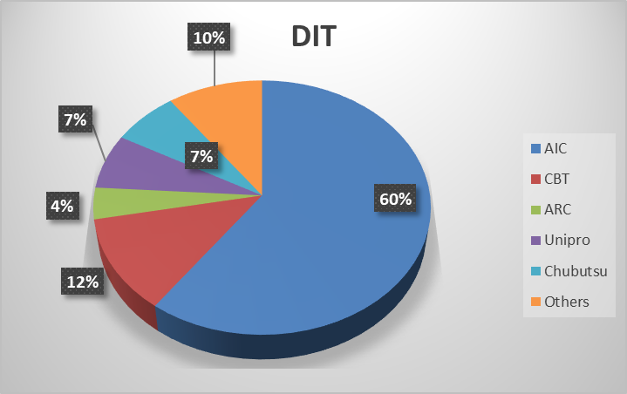
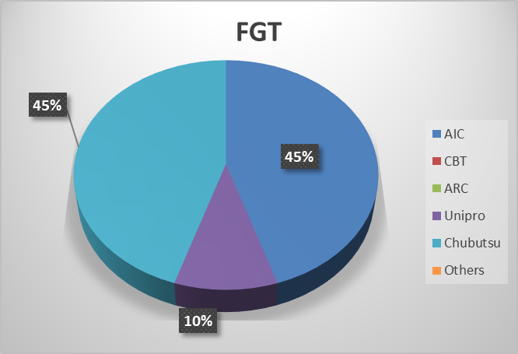
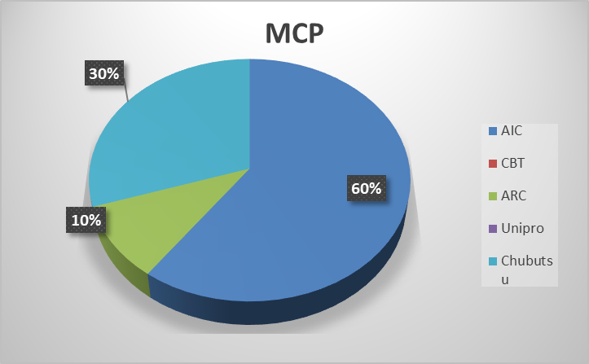
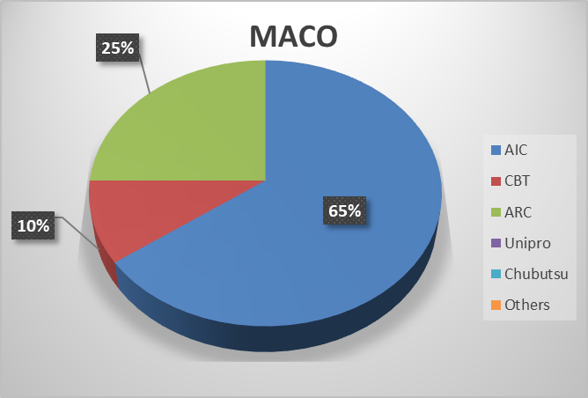
3. Market share
Customer | Market share % |  |  |  |  |  | Remark
 | AIC | CBT | ARC | Unipro | Chubutsu | Others
DIT | 60 | 12 | 4 | 7 | 7 | 10 | Share reduce 5 %
MCP | 60 |  | 10 |  | 30 |  | Share reduce 7 %
FGT | 45 |  |  | 10 | 45 |  | Share reduce 7 %
MACO | 65 | 10 | 25 |  |  |  | Share up 5 %

Slide 18
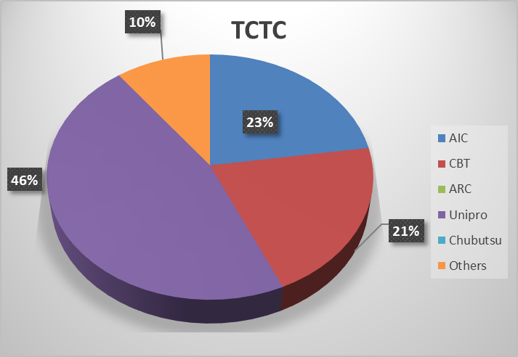
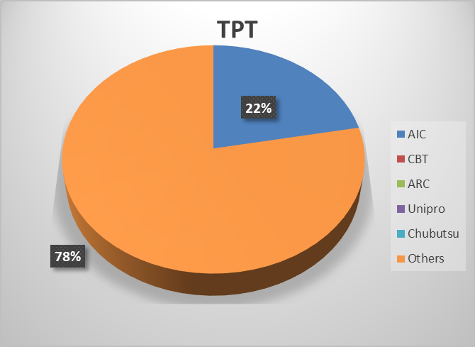
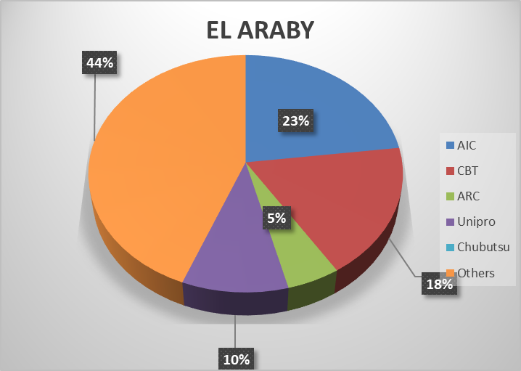
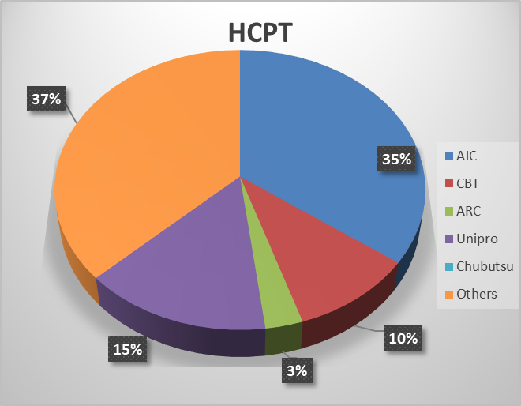
Market share
Customer | Market share % |  |  |  |  |  | Remark
 | AIC | CBT | ARC | Unipro | Chubutsu | Others
TCTC | 22 | 20 |  | 45 |  | 10 | Share up 5 %
TPT | 22 |  |  |  |  | 78 | Share up 5 %
EL ARABY | 23 | 18 | 5 | 10 |  | 44 | Share reduce 2 %
HCPT | 35 | 10 | 3 | 15 |  | 37 | Share up 5 %

Slide 19
Sales plan Y2021 (Target is 1,212 MB).
CUSTOMER |  |  | JAN | FEB | MAR | APR | MAY | JUN | JUL | AUG | SEP | OCT | NOV | DEC | TOTAL | Growth
DIT |  | 2018act | 22,453 | 27,056 | 27,625 | 20,910 | 27,529 | 27,476 | 25,147 | 21,182 | 22,092 | 28,701 | 26,131 | 20,055 | 296,355
 |  | 2019act | 24,465 | 24,412 | 29,272 | 26,119 | 29,818 | 30,742 | 27,112 | 21,090 | 25,130 | 26,018 | 25,043 | 21,010 | 310,233
 |  | 2020pln | 24,954 | 24,901 | 29,858 | 26,380 | 30,117 | 31,049 | 26,841 | 20,879 | 22,770 | 27,440 | 27,440 | 26,460 | 319,089
 |  | 2020act/Forecaset | 25,986 | 24,290 | 27,465 | 23,475 | 18,549 | 18,434 | 18,364 | 13,246 | 17,315 | 19,655 | 20,387 | 20,000 | 247,166 | 80%
 |  | 2021Annual pln | 23,000 | 25,000 | 27,000 | 25,400 | 27,100 | 26,000 | 25,600 | 22,550 | 24,500 | 26,450 | 25,400 | 22,000 | 300,000 | 121%
MCP |  | 2018act | 5,790 | 19,630 | 25,504 | 20,367 | 24,586 | 23,689 | 21,651 | 23,379 | 22,869 | 16,878 | 19,728 | 18,971 | 243,044
 |  | 2019act | 19,311 | 19,485 | 22,686 | 20,725 | 21,196 | 19,149 | 18,434 | 15,051 | 18,855 | 18,720 | 20,345 | 19,493 | 233,451
 |  | 2020pln | 19,118 | 19,290 | 22,459 | 20,518 | 20,984 | 18,958 | 18,250 | 14,900 | 16,830 | 17,820 | 17,820 | 18,810 | 225,757
 |  | 2020act/Forecaset | 21,256 | 20,193 | 23,759 | 7,149 | 5,430 | 7,340 | 14,290 | 12,346 | 21,409 | 20,095 | 22,151 | 21,000 | 196,418 | 84%
 |  | 2021Annual pln | 19,000 | 20,000 | 21,000 | 19,000 | 20,000 | 18,000 | 17,000 | 15,000 | 18,000 | 18,000 | 18,000 | 19,000 | 222,000 | 113%
MACO |  | 2018act | 7,524 | 8,201 | 9,221 | 8,274 | 8,489 | 8,048 | 6,527 | 6,833 | 6,242 | 7,725 | 9,349 | 8,941 | 95,375
 |  | 2019act | 8,859 | 8,392 | 8,800 | 8,296 | 7,307 | 8,913 | 7,501 | 6,509 | 7,761 | 9,745 | 10,686 | 9,873 | 102,641
 |  | 2020pln | 9,214 | 8,728 | 9,152 | 8,627 | 7,600 | 9,270 | 7,801 | 6,769 | 7,800 | 8,320 | 8,840 | 8,320 | 100,439
 |  | 2020act/Forecaset | 10,157 | 8,141 | 12,396 | 5,146 | 4,643 | 6,164 | 4,595 | 5,585 | 6,860 | 7,153 | 5,823 | 6,400 | 83,061 | 81%
 |  | 2021Annual pln | 8,500 | 8,000 | 8,500 | 8,000 | 7,500 | 10,000 | 8,000 | 7,000 | 8,500 | 10,000 | 10,000 | 9,000 | 103,000 | 124%
FGT |  | 2018act | 8,985 | 9,225 | 7,981 | 4,492 | 4,456 | 6,140 | 4,323 | 3,935 | 3,338 | 3,283 | 3,304 | 3,884 | 63,346
 |  | 2019act | 5,601 | 6,866 | 5,939 | 6,162 | 5,031 | 4,291 | 4,688 | 3,937 | 3,524 | 3,629 | 5,371 | 6,197 | 61,235
 |  | 2020pln | 6,722 | 8,239 | 7,127 | 7,394 | 6,037 | 5,149 | 5,626 | 4,724 | 4,200 | 3,600 | 3,840 | 3,840 | 66,497
 |  | 2020act/Forecaset | 6,972 | 8,355 | 6,262 | 4,490 | 3,599 | 3,965 | 2,867 | 3,113 | 2,808 | 4,593 | 5,071 | 3,500 | 55,596 | 91%
 |  | 2021Annual pln | 7,250 | 8,750 | 7,250 | 6,250 | 6,250 | 5,750 | 5,250 | 4,150 | 3,850 | 3,800 | 5,350 | 6,250 | 70,150 | 126%
ATC |  | 2018act | 3,729 | 2,647 | 3,058 | 2,696 | 3,210 | 3,128 | 3,405 | 3,451 | 3,199 | 4,627 | 3,566 | 2,826 | 39,541
 |  | 2019act | 3,004 | 2,725 | 1,267 | 2,523 | 2,030 | 2,390 | 2,963 | 2,813 | 2,691 | 3,189 | 2,263 | 1,372 | 29,231
 |  | 2020pln | 3,094 | 2,807 | 1,305 | 2,599 | 2,091 | 2,462 | 3,051 | 2,897 | 2,575 | 2,884 | 2,575 | 2,575 | 30,916
 |  | 2020act/Forecaset | 2,783 | 1,001 | 2,036 | 2,219 | 2,187 | 1,444 | 423 | 1,162 | 1,674 | 1,810 | 1,433 | 1,200 | 19,373 | 66%
 |  | 2021Annual pln | 2,990 | 2,975 | 1,360 | 2,560 | 2,150 | 2,560 | 2,970 | 2,850 | 2,800 | 3,200 | 2,250 | 1,335 | 30,000 | 155%
ELARABY |  | 2018act | 1,228 | 921 | 2,036 | 1,943 | 1,981 | 1,507 | 1,868 | 658 | 810 | 831 | 840 | 666 | 15,289
 |  | 2019act | 792 | 1,013 | 716 | 721 | 703 | 282 | 722 | 432 | 457 | 519 | 927 | 818 | 8,102
 |  | 2020pln | 832 | 1,063 | 752 | 757 | 738 | 296 | 794 | 475 | 770 | 792 | 770 | 792 | 8,831
 |  | 2020act/Forecaset | 1,357 | 490 | 708 | 1,181 | 1,227 | 144 | 1,006 | 898 | 837 | 593 | 898 | 1,000 | 10,340 | 128%
 |  | 2021Annual pln | 890 | 1,100 | 800 | 800 | 900 | 1,200 | 1,100 | 750 | 790 | 820 | 850 | 800 | 10,800 | 104%
TPT (W/M) |  | 2018act | 2,774 | 3,333 | 3,301 | 2,489 | 2,526 | 1,841 | 2,349 | 2,789 | 1,696 | 1,544 | 1,870 | 1,461 | 27,974
 |  | 2019act | 2,283 | 1,988 | 2,013 | 1,121 | 830 | 859 | 1,126 | 697 | 583 | 555 | 538 | 609 | 13,202
 |  | 2020pln | 2,274 | 1,982 | 2,004 | 1,113 | 808 | 810 | 1,101 | 641 | 721 | 824 | 927 | 824 | 14,027
 |  | 2020act/Forecaset | 768 | 699 | 579 | 429 | 433 | 588 | 485 | 515 | 643 | 655 | 602 | 500 | 6,894 | 52%
 |  | 2021Annual pln | 950 | 900 | 900 | 850 | 800 | 800 | 850 | 800 | 800 | 800 | 800 | 800 | 10,050 | 146%
TPT (REF) |  | 2018act | 423 | 442 | 557 | 652 | 681 | 523 | 365 | 427 | 264 | 296 | 306 | 241 | 5,177
 |  | 2019act | 189 | 115 | 188 | 141 | 140 | 172 | 196 | 192 | 23 | 169 | 143 | 249 | 1,917
 |  | 2020pln | 272 | 184 | 263 | 187 | 191 | 253 | 261 | 275 | 258 | 258 | 258 | 258 | 2,917
 |  | 2020act/Forecaset | 174 | 269 | 244 | 182 | 20 | 20 | 26 | 51 | 91 | 80 | 74 | 25 | 1,255 | 65%
 |  | 2021Annual pln | 35 | 35 | 35 | 35 | 35 | 35 | 35 | 35 | 35 | 35 | 35 | 35 | 420 | 33%

Slide 20
Sales plan Y2021 (Target is 1,212 MB).
CUSTOMER |  |  | JAN | FEB | MAR | APR | MAY | JUN | JUL | AUG | SEP | OCT | NOV | DEC | TOTAL | Growth
TCTC |  | 2018act | 1,898 | 2,232 | 2,254 | 1,815 | 1,439 | 1,883 | 1,140 | 1,291 | 1,517 | 1,030 | 1,625 | 1,091 | 19,215
 |  | 2019act | 1,890 | 2,520 | 2,154 | 2,094 | 2,260 | 1,658 | 1,517 | 1,581 | 1,512 | 1,392 | 1,890 | 1,392 | 21,860
 |  | 2020pln | 1,985 | 2,646 | 2,262 | 2,241 | 2,419 | 1,774 | 1,669 | 1,739 | 1,760 | 1,955 | 2,070 | 1,840 | 24,358
 |  | 2020act/Forecaset | 1,757 | 2,107 | 2,362 | 1,426 | 1,347 | 1,440 | 1,289 | 1,265 | 1,471 | 1,225 | 1,545 | 1,100 | 18,333 | 84%
 |  | 2021Annual pln | 1,800 | 2,200 | 2,100 | 2,000 | 2,150 | 1,700 | 1,500 | 1,500 | 1,500 | 1,400 | 1,900 | 1,400 | 21,150 | 115%
DTL |  | 2018act | 4,323 | 3,062 | 3,931 | 5,275 | 3,817 | 3,516 | 3,612 | 5,538 | 3,776 | 5,304 | 2,563 | 4,676 | 49,395
 |  | 2019act | 4,038 | 3,842 | 3,340 | 4,441 | 4,994 | 2,095 | 2,512 | 3,735 | 3,282 | 4,568 | 3,078 | 4,841 | 44,767
 |  | 2020pln | 4,160 | 3,958 | 3,441 | 4,663 | 5,244 | 2,200 | 2,688 | 3,996 | 4,066 | 4,400 | 3,850 | 4,180 | 46,845
 |  | 2020act/Forecaset | 4,202 | 4,660 | 4,326 | 4,207 | 1,143 | 598 | 2,538 | 2,888 | 5,210 | 3,742 | 2,837 | 3,500 | 39,852 | 89%
 |  | 2021Annual pln | 4,300 | 4,700 | 4,500 | 4,500 | 4,900 | 2,700 | 3,100 | 4,000 | 4,200 | 4,500 | 4,000 | 4,600 | 50,000 | 125%
TENMA |  | 2018act | 2,107 | 2,421 | 1,573 | 2,445 | 2,607 | 624 | 1,554 | 2,062 | 1,605 | 1,532 | 2,546 | 1,990 | 23,064
 |  | 2019act | 2,452 | 2,702 | 2,604 | 2,161 | 2,795 | 2,855 | 2,321 | 2,370 | 1,644 | 2,362 | 3,284 | 1,037 | 28,588
 |  | 2020pln | 2,525 | 2,783 | 2,682 | 2,225 | 2,879 | 2,940 | 2,437 | 2,022 | 2,625 | 2,625 | 3,465 | 3,675 | 32,884
 |  | 2020act/Forecaset | 2,014 | 2,157 | 2,930 | 2,442 | 1,842 | 1,337 | 2,380 | 2,692 | 1,969 | 3,101 | 3,300 | 2,500 | 28,663 | 100%
 |  | 2021Annual pln | 4,000 | 3,900 | 3,500 | 4,200 | 4,700 | 2,500 | 2,800 | 3,800 | 3,500 | 4,200 | 4,500 | 4,500 | 46,100 | 161%
ARC (FORD) |  | 2018act | 1,461 | 1,083 | 1,977 | 1,601 | 1,745 | 2,057 | 1,601 | 1,955 | 1,721 | 2,572 | 2,692 | 2,068 | 22,534
 |  | 2019act | 2,312 | 2,305 | 3,197 | 2,001 | 2,565 | 2,665 | 2,668 | 2,388 | 2,516 | 1,751 | 2,555 | 1,574 | 28,496
 |  | 2020pln | 2,427 | 2,420 | 3,357 | 2,101 | 2,693 | 2,799 | 2,801 | 2,507 | 2,625 | 2,625 | 2,625 | 2,625 | 31,606
 |  | 2020act/Forecaset | 1,976 | 1,756 | 2,464 | 809 | 7 | 228 | 1,425 | 2,783 | 1,857 | 1,829 | 2,344 | 1,800 | 19,280 | 68%
 |  | 2021Annual pln | 1,800 | 2,000 | 2,500 | 1,500 | 2,000 | 2,200 | 2,000 | 2,000 | 2,200 | 2,200 | 2,000 | 2,000 | 24,400 | 127%
ARC (MF) |  | 2018act | - | - | 1,266 | 1,027 | 1,018 | 69 | 1,972 | 493 | 243 | - | - | 377 | 6,466
 |  | 2019act | 918 | 1,716 | 121 | 1,464 | 373 | 1,397 | - | 1,631 | 755 | 1,040 | 626 | 327 | 10,366
 |  | 2020pln | 1,000 | 1,000 | 1,000 | 1,000 | 1,000 | 1,000 | 1,000 | 1,000 | 1,000 | 1,000 | 1,000 | 1,000 | 12,000
 |  | 2020act/Forecaset | 338 | 747 | 1,803 | 377 | - | 58 | 347 | - | 354 | 477 | 1,219 | 150 | 5,870 | 57%
 |  | 2021Annual pln | 500 | 500 | 500 | 500 | 500 | 500 | 500 | 500 | 500 | 500 | 500 | 500 | 6,000 | 102%
KANAYAMA |  | 2018act | 2,789 | 2,212 | 4,576 | 4,051 | 2,420 | 2,935 | 2,706 | 4,093 | 2,661 | 3,540 | 4,323 | 4,370 | 40,676
 |  | 2019act | 5,029 | 4,553 | 4,720 | 3,709 | 5,043 | 4,543 | 5,958 | 4,293 | 4,580 | 4,783 | 2,927 | 2,491 | 52,629
 |  | 2020pln | 5,230 | 4,735 | 5,244 | 3,857 | 5,244 | 4,725 | 6,197 | 4,465 | 4,763 | 4,975 | 3,044 | 2,591 | 55,070
 |  | 2020act/Forecaset | 2,940 | 2,496 | 3,498 | 2,482 | 1,918 | 2,075 | 2,662 | 2,652 | 3,378 | 2,748 | 3,868 | 2,500 | 33,217 | 63%
 |  | 2021Annual pln | 2,580 | 2,935 | 3,020 | 2,125 | 2,040 | 2,165 | 2,145 | 1,990 | 3,035 | 2,976 | 2,756 | 3,464 | 31,232 | 94%
Melco Trading |  | 2018act | 2,969 | 244 | 2,295 | 2,774 | 2,167 | 569 | 454 | 1,940 | 2,573 | 1,397 | 4,537 | 3,138 | 25,057
 |  | 2019act | 2,766 | 2,839 | 2,959 | 5,285 | 836 | 4,237 | 1,756 | 1,375 | 4,662 | 2,292 | 107 | 3,829 | 32,941
 |  | 2020pln | 2,877 | 2,952 | 2,869 | 4,497 | 2,869 | 3,406 | 1,827 | 1,430 | 3,848 | 2,384 | 1,111 | 3,982 | 34,051
 |  | 2020act/Forecaset | 2,988 | 3,623 | 3,662 | 3,275 | 242 | 0 | 10 | 4,152 | 4,302 | 6,429 | 1,805 | 2,500 | 32,990 | 100%
 |  | 2021Annual pln | 2,500 | 2,800 | 3,000 | 2,700 | 3,000 | 3,000 | 2,000 | 2,000 | 3,300 | 2,500 | 2,000 | 2,500 | 31,300 | 95%
CB Tact |  | 2018act | 1,747 | 2,321 | 1,516 | 1,185 | 1,414 | 1,394 | 1,048 | 1,157 | 1,765 | 1,557 | 1,384 | 2,177 | 18,664
 |  | 2019act | 2,099 | 1,319 | 1,714 | 1,235 | 1,652 | 1,056 | 1,048 | 975 | 980 | 1,146 | 885 | 1,621 | 15,731
 |  | 2020pln | 2,204 | 1,385 | 1,735 | 1,297 | 1,735 | 1,109 | 1,100 | 1,024 | 1,029 | 1,204 | 929 | 1,702 | 16,453
 |  | 2020act/Forecaset | 1,738 | 2,632 | 2,359 | 1,762 | 478 | 285 | 443 | 842 | 1,524 | 1,356 | 1,649 | 1,000 | 16,068 | 102%
 |  | 2021Annual pln | 1,500 | 2,000 | 1,800 | 1,300 | 1,800 | 1,200 | 1,100 | 1,000 | 1,000 | 1,100 | 1,000 | 1,200 | 16,000 | 100%

Slide 21
Sales plan Y2021 (Target is 1,212 MB).
CUSTOMER |  |  | JAN | FEB | MAR | APR | MAY | JUN | JUL | AUG | SEP | OCT | NOV | DEC | TOTAL | Growth
FKT (PU Law Material） |  | 2018act |  |  |  |  |  |  |  |  |  |  |  |  | -
 |  | 2019act |  |  |  |  |  |  |  |  |  |  |  |  | -
 |  | 2020pln |  |  |  |  |  |  |  |  |  |  |  |  | -
 |  | 2020act/Forecaset | - | - | 135 | 135 | - | 79 | 190 | 210 | 180 | 202 | 225 | 100 | 1,457
 |  | 2021Annual pln |  |  |  |  | 1,000 | 1,000 | 1,000 | 1,000 | 1,000 | 1,000 | 1,000 | 1,000 | 8,000 | 549%
Midea, Beko |  | 2018act |  |  |  |  |  |  |  |  |  |  |  |  | -
 |  | 2019act |  |  |  |  |  |  |  |  |  |  |  |  | -
 | New Customer① | 2020pln |  |  |  |  |  |  |  |  |  |  |  |  | -
 |  | 2020act/Forecaset |  |  |  |  |  |  |  |  |  |  |  |  | -
 |  | 2021Annual pln |  |  |  | 100 | 100 | 200 | 200 | 300 | 300 | 300 | 500 | 500 | 2,500
Customer②Duct insulation |  | 2018act |  |  |  |  |  |  |  |  |  |  |  |  | -
 |  | 2019act |  |  |  |  |  |  |  |  |  |  |  |  | -
 | New Customer② | 2020pln |  |  |  |  |  |  |  |  |  |  |  |  | -
 |  | 2020act/Forecaset |  |  |  |  |  |  |  |  |  |  |  |  | -
 |  | 2021Annual pln |  |  |  | 400 |  | 500 |  | 700 |  | 700 |  | 700 | 3,000
Customer③PE Block (excluding RP-300S and SA parts) |  | 2018act |  |  |  |  |  |  |  |  |  |  |  |  | -
 |  | 2019act |  |  |  |  |  |  |  |  |  |  |  |  | -
 | New Customer③ | 2020pln |  |  |  |  |  |  |  |  |  |  |  |  | -
 |  | 2020act/Forecaset |  |  |  |  |  |  |  |  |  |  |  |  | -
 |  | 2021Annual pln |  |  |  | 400 | 400 | 400 | 400 | 400 | 500 | 500 | 500 | 500 | 4,000
Others |  | 2018act | 16,298 | 17,798 | 14,739 | 8,890 | 11,512 | 13,011 | 5,886 | 8,499 | 10,260 | 9,420 | 11,218 | 11,004 | 138,534
 |  | 2019act | 8,566 | 15,670 | 14,166 | 10,279 | 12,188 | 10,316 | 11,090 | 10,496 | 8,816 | 8,012 | 9,335 | 10,254 | 129,189
 |  | 2020pln | 11,037 | 19,329 | 16,015 | 14,859 | 13,602 | 16,140 | 14,009 | 15,055 | 13,650 | 15,328 | 19,906 | 16,714 | 185,644
 |  | 2020act/Forecaset | 13,306 | 13,746 | 14,313 | 13,130 | 10,737 | 8,364 | 8,377 | 8,604 | 7,205 | 10,219 | 10,861 | 12,250 | 131,112 | 101%
 |  | 2021Annual pln | 19,254 | 20,518 | 20,759 | 19,659 | 20,152 | 17,973 | 16,100 | 15,635 | 16,354 | 17,070 | 19,668 | 19,259 | 222,401 | 170%
 |  | 2018act G.TTL | 86,498 | 102,827 | 113,412 | 90,888 | 101,596 | 98,412 | 85,609 | 89,681 | 86,631 | 90,237 | 95,982 | 87,936 | 1,129,708
 |  | 2019act G.TTL | 94,575 | 102,462 | 105,856 | 98,476 | 99,762 | 97,619 | 91,612 | 79,564 | 87,770 | 89,889 | 90,004 | 86,988 | 1,124,577
 |  | 2020pln G.TTL | 99,923 | 108,402 | 111,524 | 104,316 | 106,251 | 104,338 | 97,452 | 84,798 | 91,290 | 98,433 | 100,470 | 100,189 | 1,207,383
 |  | 2020act/Forecaset G.TTL | 100,712 | 97,362 | 111,302 | 74,318 | 53,802 | 52,564 | 61,716 | 63,002 | 79,089 | 85,962 | 86,093 | 81,025 | 946,946 | 84%
 |  | 2021Annual pln G.TTL | 100,849 | 108,313 | 108,524 | 102,279 | 107,477 | 100,383 | 93,650 | 87,960 | 96,664 | 102,051 | 103,009 | 101,343 | 1,212,503 | 128%

Slide 22
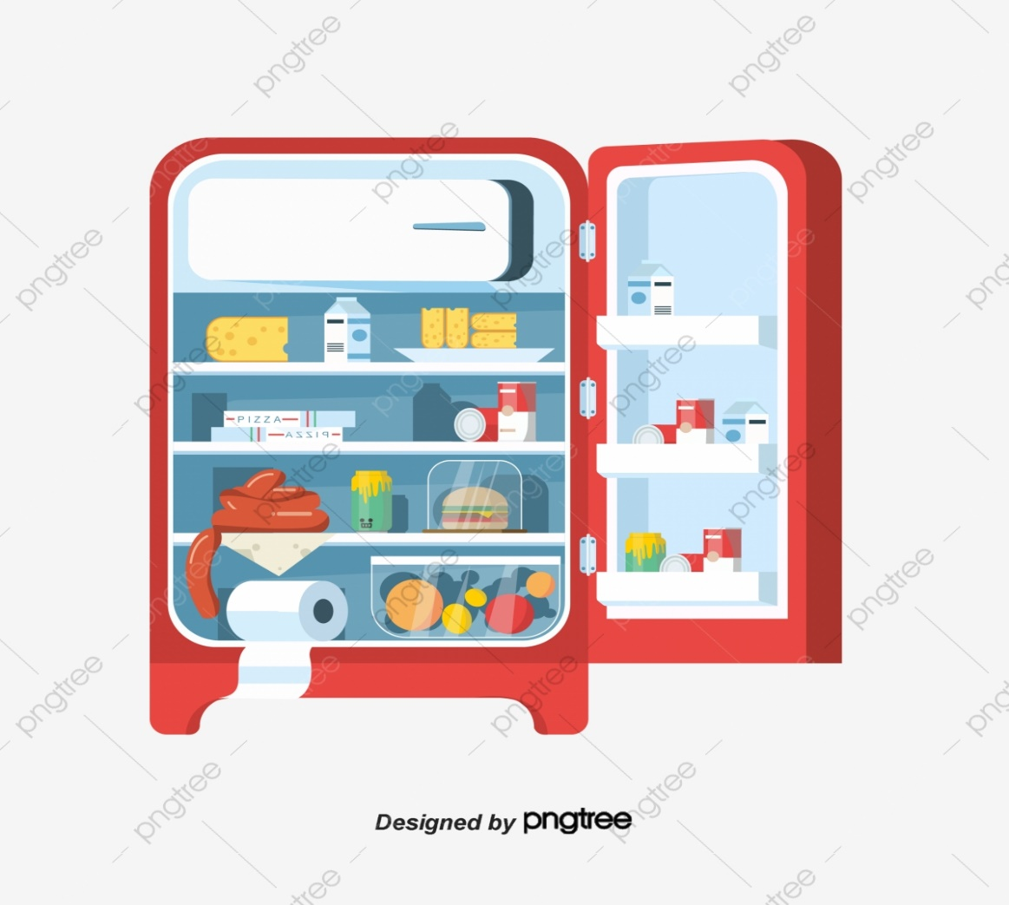

Thank you

